Slide 1
MANUFACTURING
Visual Work Instruction Agent
Subfunction
Maturity
Converts expert walkthroughs into visual SOPs to accelerate training and reduce errors.
Industrial
Strategic Imperatives
Lack of documented processes and reliance on tribal knowledge hinder onboarding and consistent task execution across shifts and locations
Current Workflow Challenges
Operator training depends on shadowing and static manuals
Missing or unclear SOPs lead to inconsistent task execution
High error rates from misunderstood instructions
Valuable expert knowledge is lost when experienced workers leave
Inconsistent training quality due to SME dependency
Training materials / guidance becomes obsolete, outdated, or incorrect when processes change
Slower time to proficiency for new joiners
Key Features
Business Impact
From
Ingests multimedia recordings (video/audio/screens) from wearables, mobile, and HMI systems to preserve expert knowledge
Training Time → Accelerated onboarding through engaging digital guides
Extracts and transcribes spoken instructions using speech-to-text models and aligns them with visual workflows
SOP Completion Rate → Clear step-by-step visuals improve task adherence
Error Rate → Visualized instructions reduce misunderstandings and mistakes
Segments recordings into structured procedures with annotated visuals and safety callouts
Convert expert walkthroughs into annotated, step-by-step visual instructions to deliver contextual guidance that frontline workers can access directly from their workspace
To
Enhances each step with annotated visuals, callouts, and safety warnings for better comprehension
Key User(s)
AI Agent drives real-time intent identification, intelligent routing, and hyper-personalized recommendations
Manufacturing Engineer
Training Coordinator
Publishes interactive visual work instructions via MES or content management systems for use in training and daily operations
Frontline Operator
Enable operator feedback on unclear instructions, routing insights to engineers or triggering agent reviews

Slide 2
Manufacturing
Visual work instruction agent
Available with:
Copilot Studio
Scenario level:
Extend
Ingest multimedia capture
Transcribe & align instruction
Segment and annotate process steps
Automatically generates visual standard operating procedures (SOPs) from expert walkthroughs to speed up training and reduce errors.
KPIs impacted
Value benefit
Collects expert walkthroughs via mobile, wearable, or HMI recordings.
Transcribes spoken guidance and synchronizes it with video steps.
Converts recordings into structured, annotated SOPs.
AI Agent
Connection to IoT Systems (e.g., HMI logs) for video and interface recordings
Connection to Mobile Devices (e.g., Android/iOS) for camera feeds
Connection to Knowledge Base (e.g., SharePoint) for storage and retrieval
AI Agent
Connection to speech recognition service for real-time transcription
Connection to Video Platform (e.g., Microsoft Stream) for audio-video synchronization
Connection to ERP (e.g., Dynamics 365) for step references or operation metadata
AI Agent
Connection to computer vision service for activity recognition
Connection to MES (e.g., Dynamics 365 SCM) for aligning SOP steps with operations
Connection to Knowledge Base (e.g., SharePoint) for annotation templates and tagging
Benefit: Collects recording to preserve expert knowledge in rich, reviewable formats.
Benefit: Extracts and transcribes spoken instructions, to be aligned with visual workflows, to speed up the process.
Benefit: Standardizes complex procedure into visual instructions.
Reduces Training Time
Improves Task Adherence
Enhance interactive SOP
Publish interactive SOP
Enhance safety & compliance
Reduces Error Rate
Enables operator feedback on unclear steps, routing insights to engineers or triggering agent reviews.
Publishes SOPs into systems frontline workers already use.
Adds safety warnings, PPE icons, and compliance callouts to instructions.
AI Agent
Connection to Instruction Interface (e.g., embedded SharePoint or Teams) for capturing operator feedback
Connection to Workflow Tools (e.g., Power Automate) for routing feedback to safety teams
Connection to Agent Orchestration System (e.g., Power Platform) to trigger reviews by relevant agents (e.g., Manufacturing Inspector Agent)
AI Agent
Connection to MES (e.g., Dynamics 365 SCM) for task-linked guidance
Connection to Knowledge Base (e.g., SharePoint) for instruction hosting
Connection to Collaboration Tools (e.g., Teams) for training delivery
AI Agent
Connection to EHS System (e.g., Dynamics 365 EHS) for safety rule integration
Connection to Compliance Repository (e.g., SharePoint) for policy linkage
Connection to MES (e.g., Dynamics 365 SCM) for context-aware hazard info
Cost savings
Employee Experience
Benefit: Enhances SOP quality through frontline feedback and expert review cycles on flagged issues.
Benefit: Publishes SOPs into systems to empower workers with real-time access to validated instructions.
Benefit: Adds safety warnings, PPE icons, and compliance callouts to reduce operational risk and improve regulatory compliance.

Slide 3
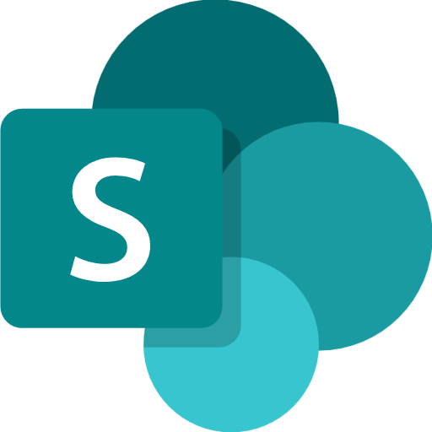
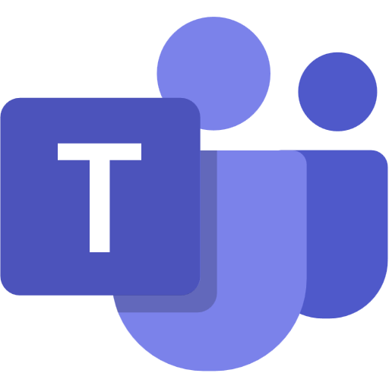
MANUFACTURING INDUSTRY
Visual Work Instruction Agent
Converts expert walkthroughs into visual SOPs to accelerate training and reduce errors.
Key Considerations to Address
Pulls expert videos from HMI systems and SOPs from MES system and store as knowledge
Detects actions in video, aligns with MES (e.g., Dynamics 365) operations, and tags steps using templates from SharePoint.
Captures the audio/ video transcript and push them as knowledge
Pulls safety data from EHS (e.g., Dynamics 365) and compliance rules from Knowledge Base (e.g., SharePoint) to give rich SOPs in overlaid PDF format
Routes flagged instruction steps from operator feedback to safety teams via Workflow Tools (e.g., Power Automate), triggering reviews through Agent Orchestration Systems (e.g., Power Platform)
PII includes faces and voices of experts in videos.
1c. Invokes speech to text endpoint and extracts transcript
Base Pre-trained OpenAI Models / custom Open AI models (preview)
9c. Sets the agent confidence threshold and updates instructions and prompts,
Orchestrator
Azure Function Apps
Azure Speech to Text
Low
instruction_confidence
High
Licensed Users
0
1
5. Forwards query
1b.Sends multimedia recordings
1d. Recordings and extracted text sent and generates transcript score
6. Invokes tools
7b. If confidence score <0.7, escalate
HMI System
1e. Sends SOP documents
1a. Stores the learning content multimedia
7a. If confidence score >= 0.7, sends summary with citation to video links
Manufacturing Engineer
EHS System
Tools
2. Past hazard info stored and labeled
Knowledge Base
4. Asks for audio/ visual guidance for maintenance of specific equipment
Channels
MES System
Structured Records
8. Response
1f. Sends hazard info
Structured Records
Unstructured Documents (versioned)
Training Coordinator
LEGEND
Rest API
6a. Calculates confidence score
Prompts
Connector
3. SOPs docs are stored
D365 Customer Portal
1da. If the transcript score is low, sends for human review
Dataverse
Frontline Operator
SharePoint
9a. Agent logs are displayed
Agent-to-Agent
Workflow
Production Schedule Optimizer Agent
Copilot Studio Agent
Conversation Transcript
Agent Ops (logging, audit, observability)
Reference Architecture Assumptions
Agent will be hosted on Teams channel with Microsoft authentication
Engineer, coordinator will have M365 license to access the agent,
EHS , SAP and HMI systems would expose APIs or have connectors to fetch hazard info, SOP documents
PDF, PPTX and DOCX are the supported knowledge in SharePoint. Dataverse knowledge can be max two with max 15 tables each.
Other dependent agents should be ready and discoverable to be associated with this agent
App Insights
9b. Logged entries are reviewed
Copilot Studio Kit - Extend
Flow / Connector
MS Teams

